Slide 1
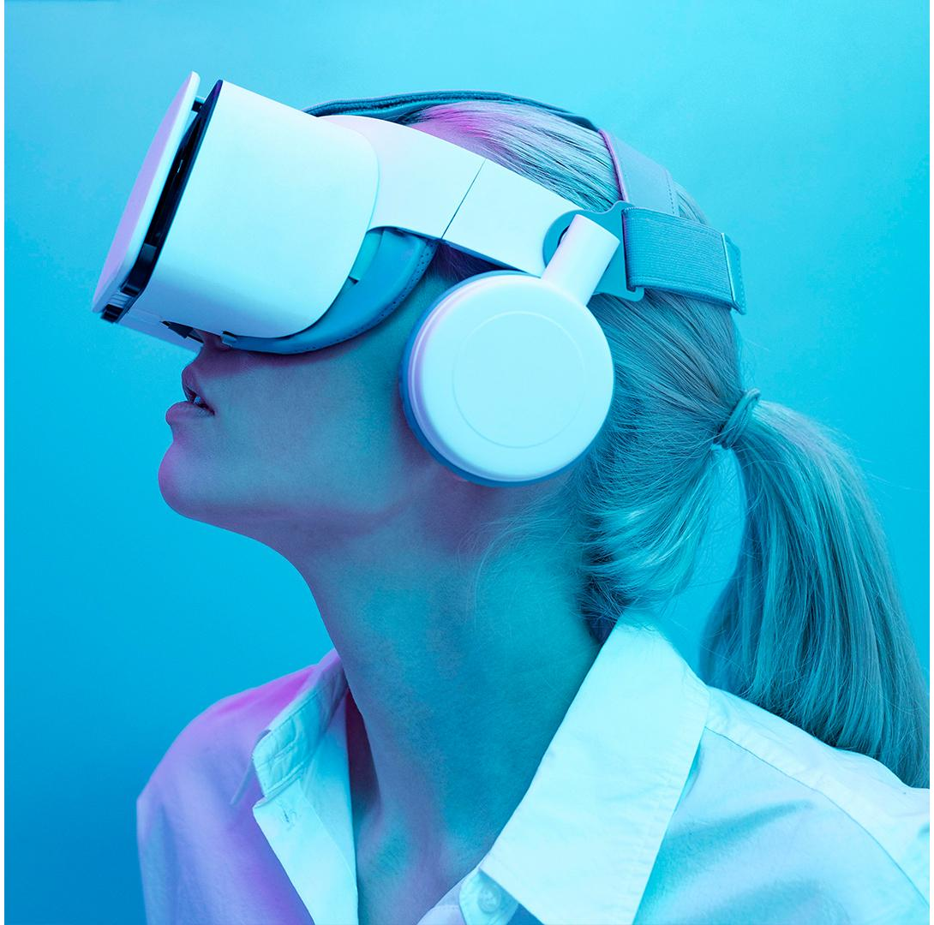
Foldable Spaces
01
An Overt Redirection Approach for Natural Walking in
Virtual Reality
Authors: Jihae Han, Andrew Vande Moere, Adalberto L. Simeone
2022 IEEE Conference on Virtual Reality and 3D User Interfaces (VR)
Diogo Almeida nº108902
Tomás Matos nº108624
Interação Humano Computador Eng.Informática

Slide 2
What are foldable spaces?
02
Foldable spaces are a way of dealing with the Virtual Environment in order to walk a space larger than the real-life tracking space.

Slide 3
Principle Research Questions
03
To what extent do the foldable redirection techniques affect how users walk in a VE (walking speed and variation, idle time and frequency, walking trajectories)?
To what extent do the foldable redirection techniques affect how users cognitively engage with a VE (memory recall, distance estimation, sketch maps)?
Does the ‘overtness’ of the manipulation constitute a break in Presence too great to be ignored?

Slide 4
Relative Work
Subtle techniques
01
02
Impossible Spaces
Change Blindness Redirection
03
Flexible Spaces
04
Scenography
04
Makes subtle changes to the environment while the user is distracted to influence their trajectory
Compresses a large area into a smaller physical space, overlapping discrete parts of the VE
Expands the "Flexible Spaces" technique with the generation of corridors that connect several virtual rooms within the same physical space
Adapts these techniques to create a natural walking experience independent of tracking volume.

Slide 5
Overt techniques
01
Reset Vision
02
Teleport
03
Foldable Spaces
05
Subdivide the VE into spaces that dynamically fold as the user moves

Slide 6
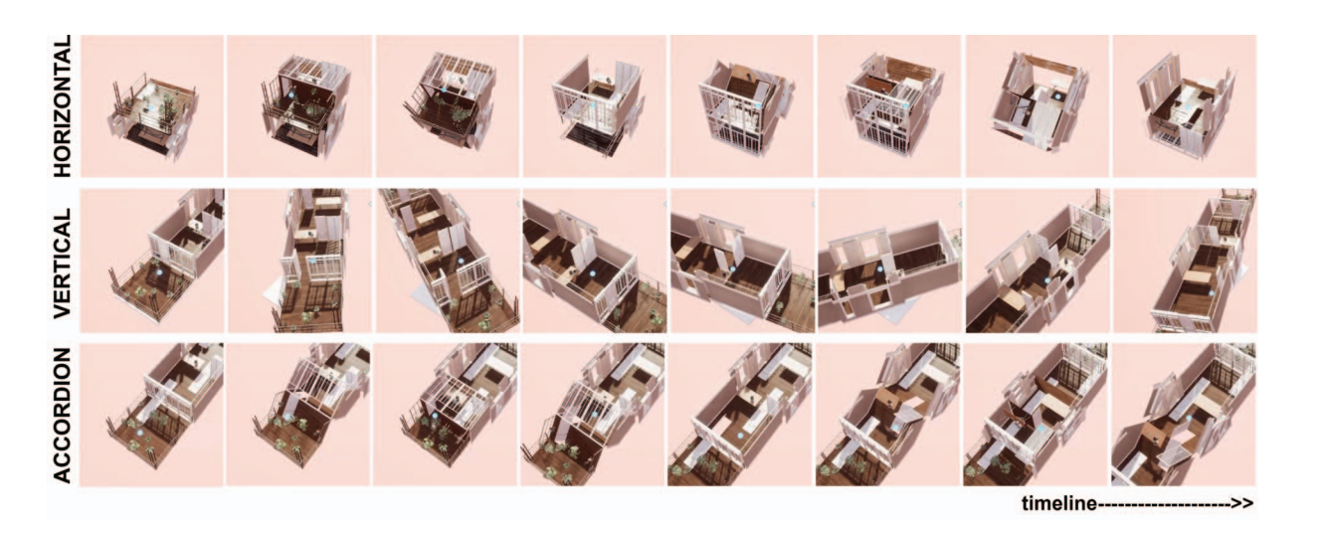
Foldable Techniques
06

Slide 7
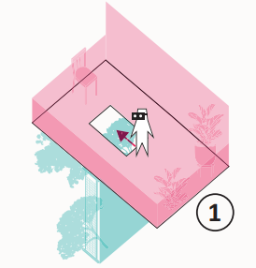
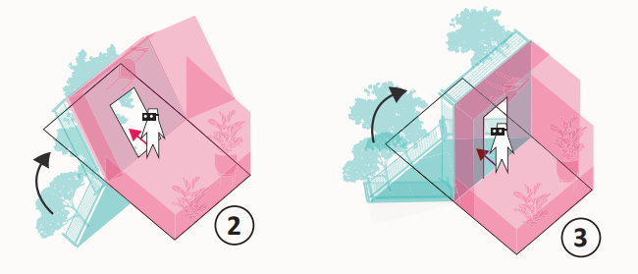

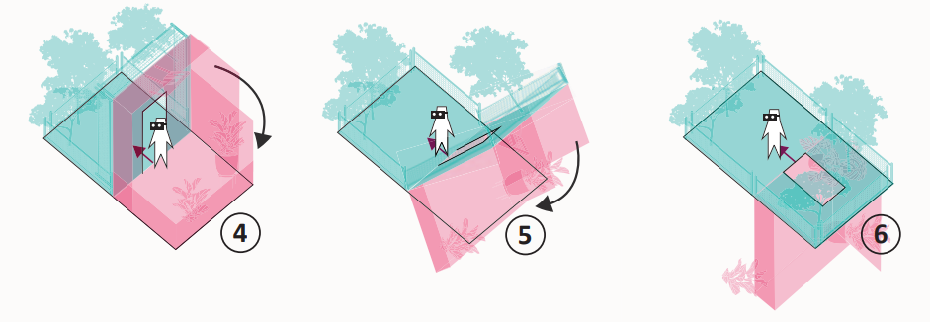
Horizontal
PHASE 01
PHASE 02
07
PHASE 03

Slide 8
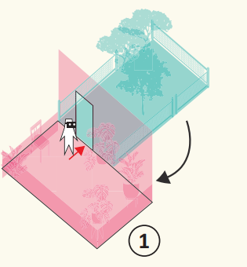
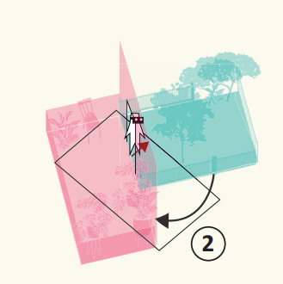
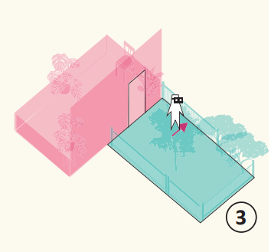
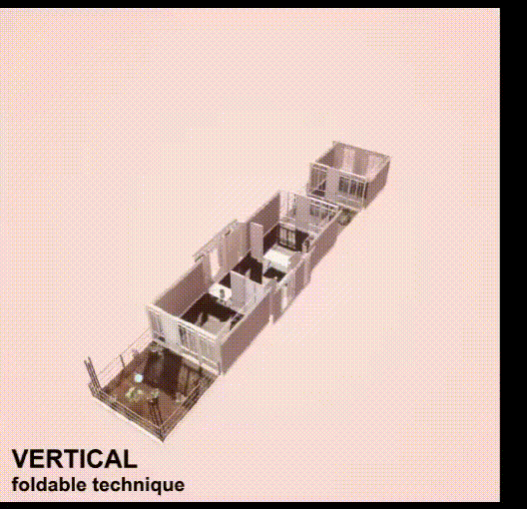
Vertical
08
PHASE 01
PHASE 02
PHASE 03

Slide 9
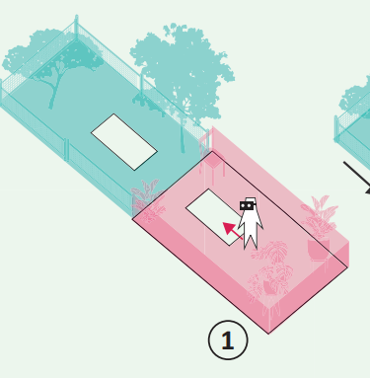
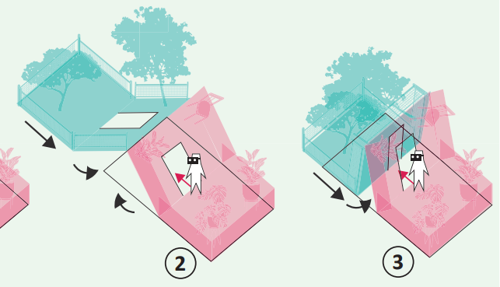
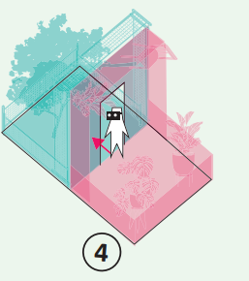
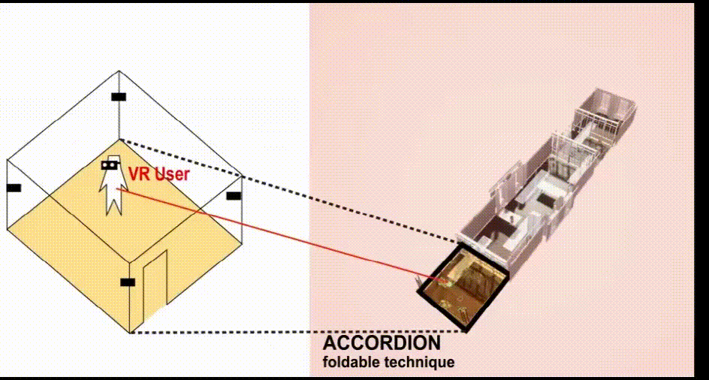
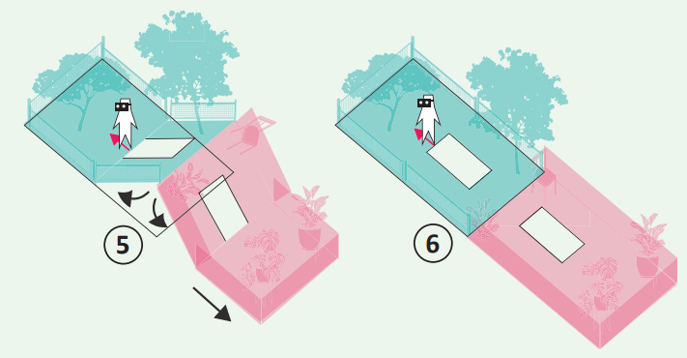
Acordeão
PHASE 01
PHASE 02
09
PHASE 03

Slide 10


EXAMPLE
10

Slide 11
USER STUDY
For each Participant
01
Quantitative evaluation
02
Qualitatively evaluation
11
Performance on the walking and cognitive task
Subjective classification, questionnaires, thematic analysis of interviews and sketch maps

Slide 12
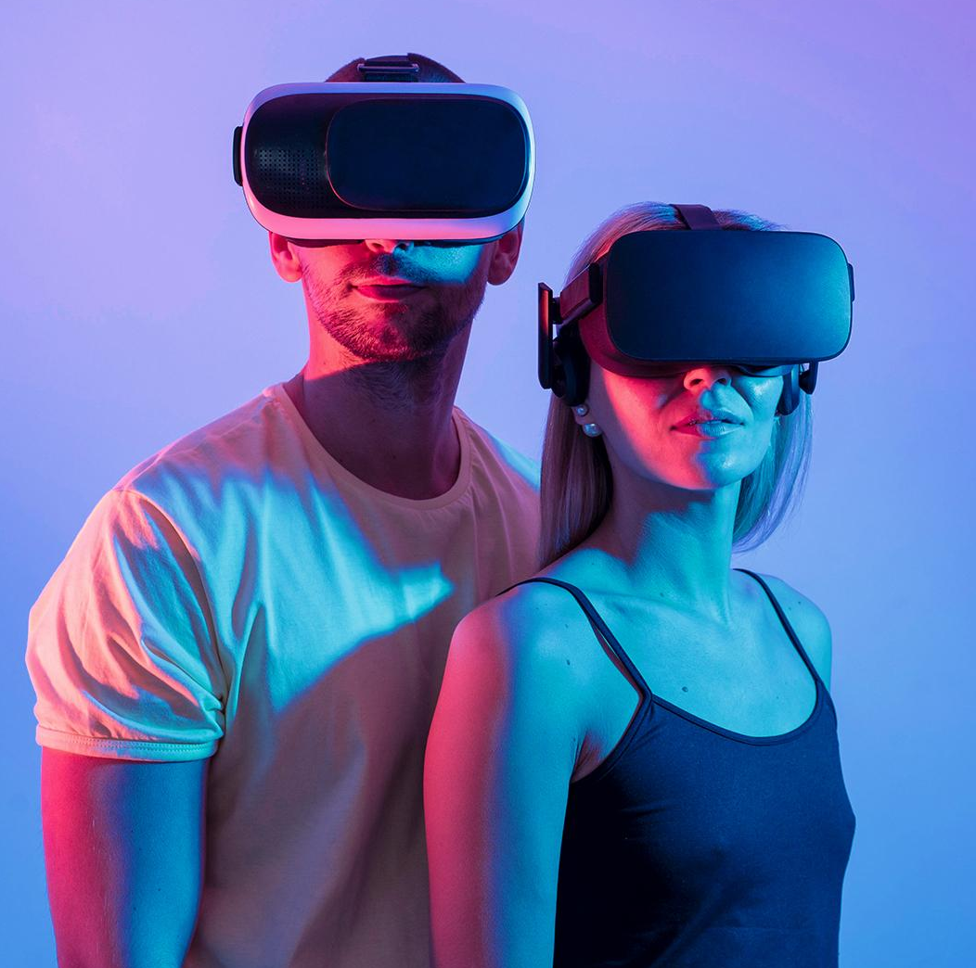
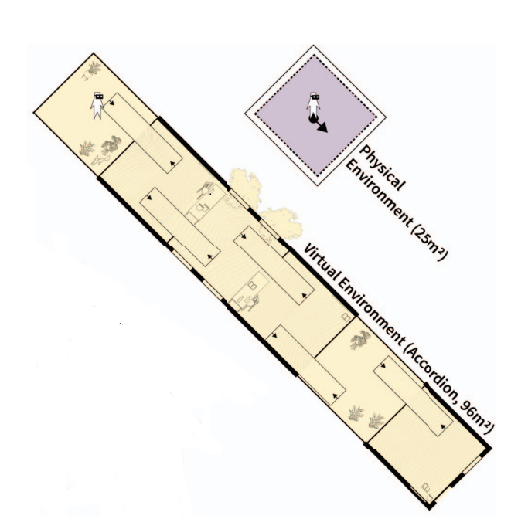
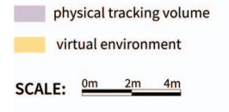
Virtual Environment
Evaluation Rules
13
Participants had 3 minutes each tentative
Each trial occurred in the same VE with the same number of virtual objects; however, the location of these virtual objects was different.
Each VE contained 3 bottles, 3 photos, 3 books, 2 chairs, 2 tables, 2 trees, 1 fox, 3 pots without plants and 6 indoor plants as shown in figure.

Slide 13
Items to search
14
3 Bottles - o
3 Photos (nor visible from above)
3 Books - o
2 Chairs - o
2 Tables - o
2 Trees - o
1 Fox - o
3 Pots - o
6 Plants - o

Slide 14
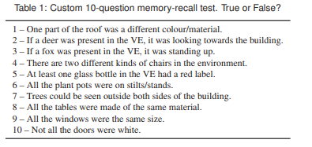
Post-Experiment
12
01
02
03
10 question memory test
Sketch map exercise
Short interview to get feedback

Slide 15
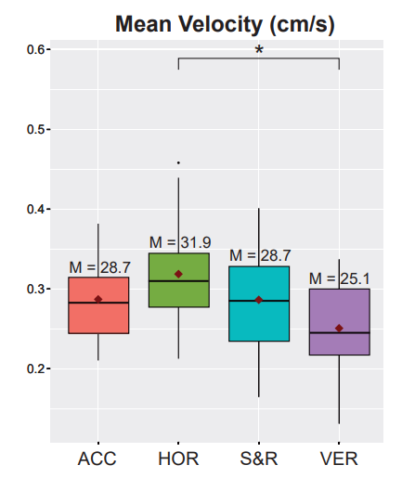
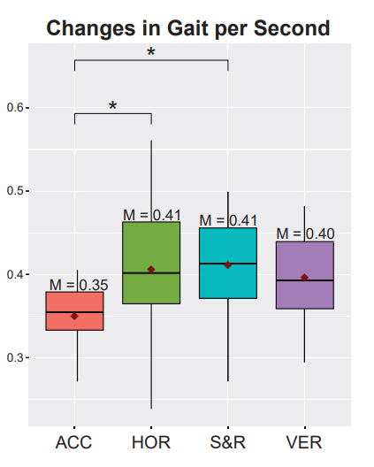
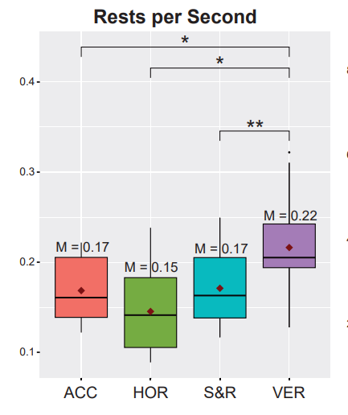
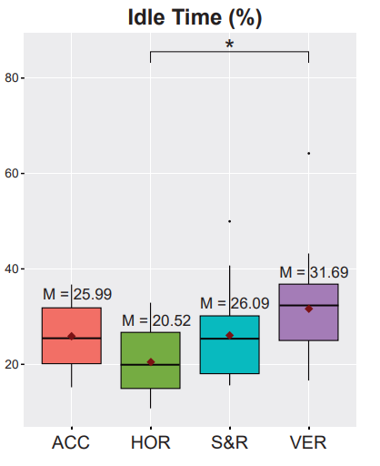
Results
15
1º - Horizontal (M=31.9 cm/s, Max=45.8 cms)
2º - Stop&Reset (28.7 cm/s, Max=40.1 cm/s)
2º - Accordion (M=28.7 cm/s, Max=38.2 cm/s)
3º - Vertical (M=25.1 cm/s, Max=33.8 cm/s)
1º - Accordion (M=0.35Δ/s)
2º - Vertical (M=0.40Δ/s)
3º - Stop&Reset (M=0.41Δ/s)
3º - Horizontal (M=0.41Δ/s)
1º - Horizontal (M=0.15)
2º - Stop&Reset (M=0.17)
2º - Accordion (M=0.17)
3º - Vertical (M=0.22)
1º - Horizontal (M=20.52%)
2º - Accordion (M=25.99%)
2º - Stop&Reset (M=26.09%)
3º - Vertical (M=31.69%)

Slide 16
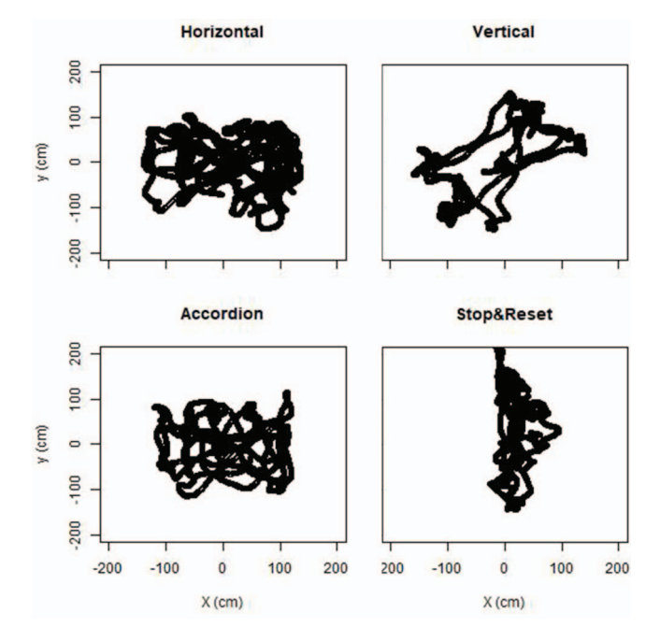
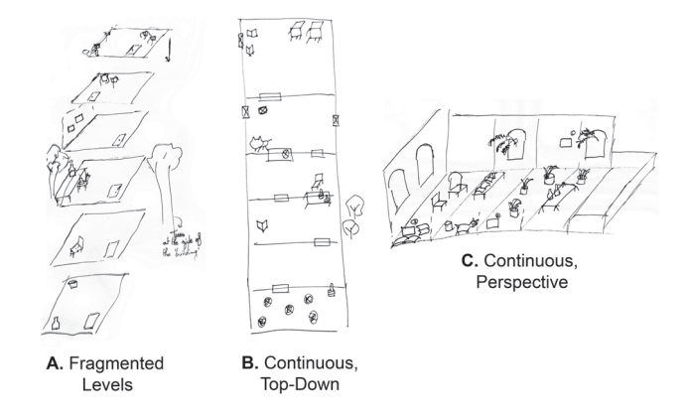
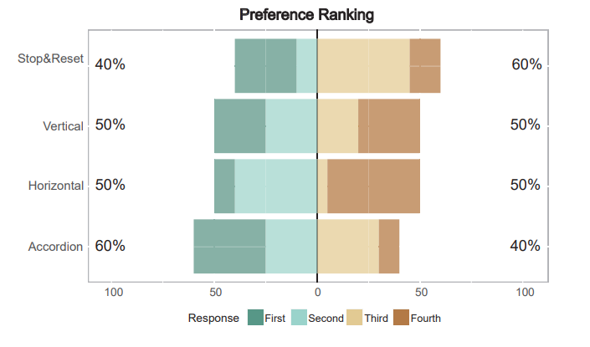
More Results
16
Security
Sketch Map
Preference Ranking

Slide 17
Discussion
17
Q1
Affect how users walk in a VE on Foldable redirection techniques
Q2
How users cognitively engage with a VE with Foldable redirection techniques
Q3
Does the ‘overtness’ of the manipulation constitute a break in Presence too great to be ignored?

Slide 18
Future
Work
18

Slide 19
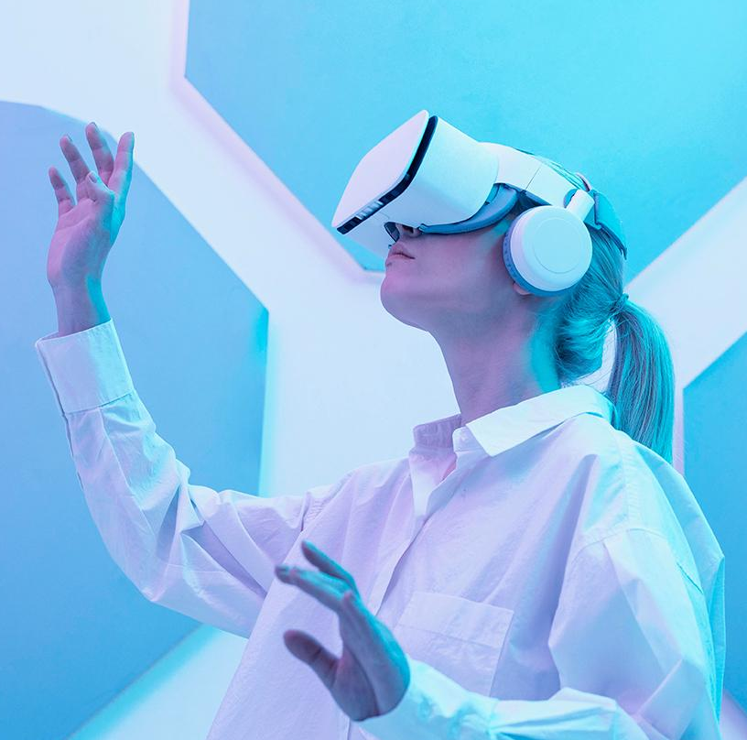
THANKS!
19
Do you have any questions?

